Slide 1
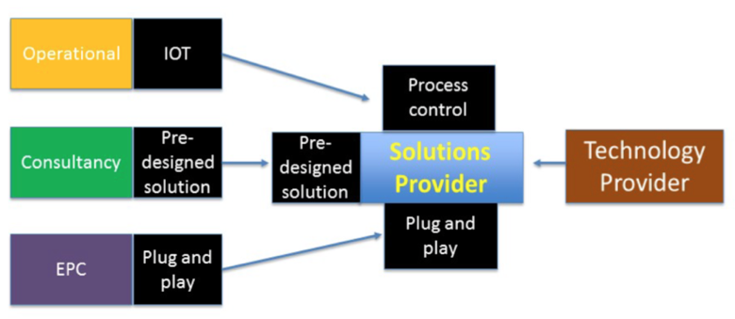
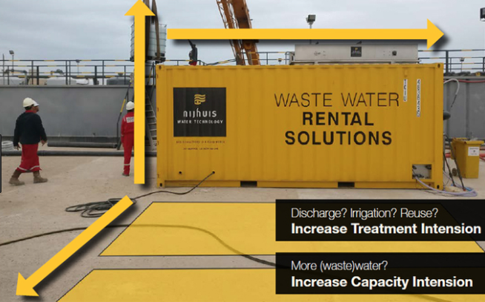

It’s All About the Business Model
1) Shifts in the Value Chain
A fundamental shift in the value chain towards solutions providers, or companies which seek to offer a comprehensive range of goods and services under one roof and can also become service providers through IoT-enabled remote operation and water-as-a-service business models.
3) Water-as-a-Service (WaaS) & Financing
WaaS service models can include construction, installation, ownership and operation of assets. The end user pays for performance on a per m³ basis. A recent example is Cambrian Innovation who accelerated technology adoption by offering a WEPA (Water-Energy Purchase Agreement).
Trends in Business Models
1) Shifts in the Value Chain
2) Technology Rental/Leasing
4) Data-as-a-Service (DaaS)
3) Water-as-a-Service (WaaS) and Financing Options
2) Technology Rental/Leasing
Companies offer mobile rental solutions which can include remote monitoring of technologies. Benefits:
Fast response to meet plant needs
Flexible modular solutions, easy, on-demand expansion
Tap into operational rather than capital budgets
4) Data-as-a-Service (DaaS)
Selling data to the clients using custom data analytics and machine learning (AI) algorithms. DaaS service models are usually set up as a pay as you go service with no capital expenditure required on equipment. A couple examples of DaaS providers in the water sector:
Other areas we could explore:
Value from waste plays, and example business models (Ostara, Nijhuis)
Adoption of models from other sectors -> royalty-based models?
Examples of cost-savings / profit sharing models working in water?
Other “DaaS” & optimization opportunities – increasing “up-time”, metagenomics, etc.

