Slide 1
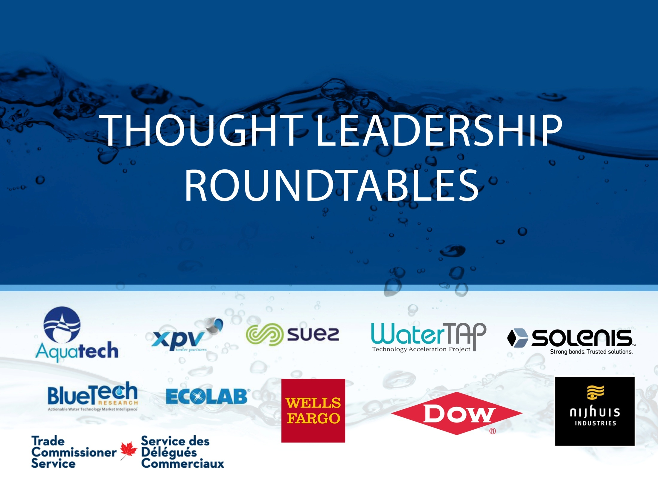

Slide 3
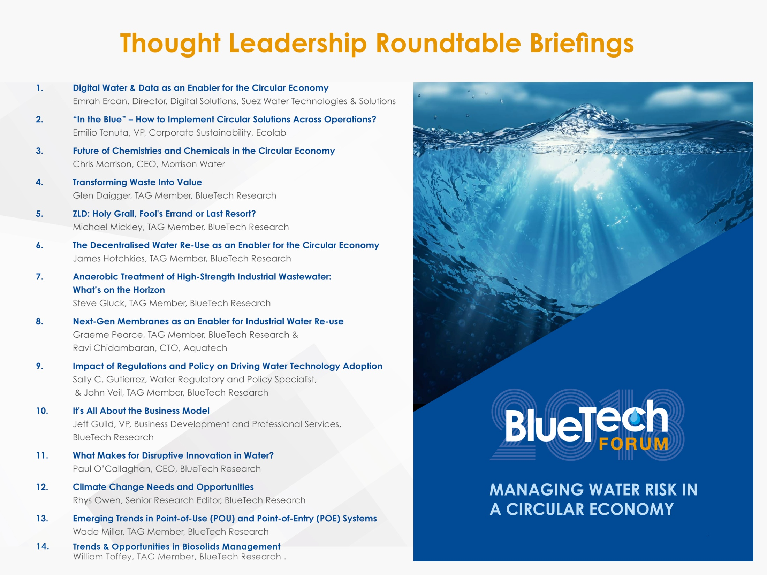

Slide 4


1. Digital water & data as an enabler of the circular economy
1. Lack of visibility into operational issues, whether “outside the fence” water infrastructure or “inside the fence” challenges like energy and water usage (proactive – turning to digital to find solutions for resource challenges)
2. Corporate mandates – companies are continuing to focus on sustainability (both reactive as well as proactive)
3. Stronger compliance regulations (reactive to meet new requirements for water quality, usage and discharge)
1. Asset Performance Management (APM) software offers operators actionable data about their plant’s water consumption and helps implement real changes that decrease water use.
2. Big data analytics allow operators to collect data on water across the entire treatment cycle and offer greater visibility into how the process can be run more effectively and efficiently using targeted analytics.
3. Machine learning to help water treatment process become “smarter”. Machine learning uses algorithms to learn from and make predictions based on data.
1. Budgetary pressures - When new solutions are needed to reduce operating costs, digital is a key enabler but there is still a cost associated with it
2. Perception of value – lack of understanding can make digital technologies seem like a “nice to have” instead of a “must have”
3. Pace of advancement –There is a fear factor associated with making a big investment for something that may quickly become obsolete
1. Technology providers – Microsoft Azure, Amazon Web Services, focused platform providers like C3 IoT have partnered with water treatment providers to enable the creation and adoption of new technologies.
2. Water industry leaders – the Ellen MacArthur Foundation ; solution providers like SUEZ and Nijhuis that have made the circular economy a core piece of their mission and value proposition to customers.
3. Key water-intensive industries like Oil & Gas, Refining, Power and Food & Beverage, as well as municipalities (including SUEZ clients like the city of Abilene, TX on the municipal side and the Co-op Refinery Complex in Canada, among many others.
What is driving this market?
Other assisting factors
The circular economy of water will only become more and more important, and the role of digital as a key enabler will grow as well.
At the same time, technology is moving quickly. The digital tools that are cutting-edge today, and are in use across thousands of operations may not be that way going forward, as more effective enabling technologies are developed and come onto the market.
The rise of newer concepts like machine learning and artificial intelligence (AI), while not as well understood today as some of the other core technology platforms, have the potential to be disruptive to the current digital platforms and technologies being deployed across the water industry.
Market Outlook
SCADA
AMI
Blockchain
CIS
What are the current market barriers?
Who will win out?
AI
GIS
Satellite

Slide 5
2. “In the Blue” – How can You Implement Circular Economy Solutions Across Operations?
In their 2017 Water Management Survey, GreenBiz and Ecolab found that water is a growing priority for mid-sized and large companies:
75% have water-related targets. But so far, implementation falls short.
82% of the companies surveyed lack the tools and strategies to build circular water management practices.
Mission Statement
Currently, too many companies lack a smart water management strategy. Our aim is to help companies move up the water maturity curve, and from nascent conservation efforts toward circular solutions fully embedded across their operations, based on the principle “re-use, repurpose and recycle.”
Build a sense of urgency
Demand for water will outstrip supply by 40% by the year 2030
Build foresight
To avoid problems in the future, companies need to take steps to learn about their local facilities’ risk factors today. That means collecting and interpreting data and adopting appropriate “Internet of Things” measurement solutions.
Gather the resources to act
Water must be integrated into decision-making at the individual facility level.
- Ecolab’s Water Risk Monetizer can help companies put a dollar-value on their individual locations’ water risk and prioritize accordingly.
- “In the Blue,” a tool that Ecolab will launch later this year, will help identify and implement the practical action steps to move up the maturity curve.
Collaborate
Smart water stewardship requires collaboration between stakeholders (industry, agriculture, local communities and others) as well as between the private sector, government and civil society.

Slide 6
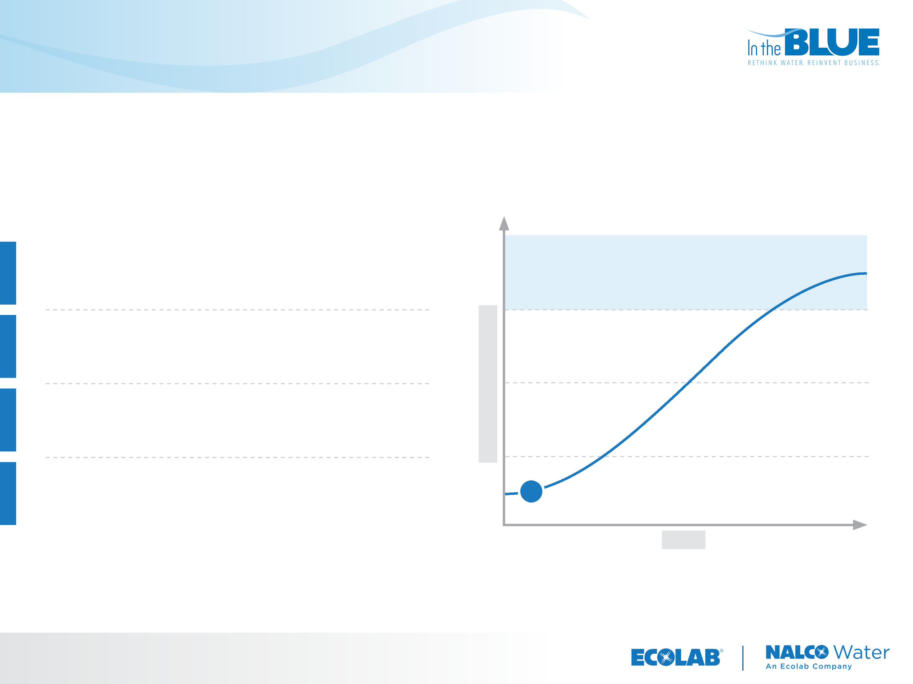
In the Blue Maturity Curve
Through a questionnaire, users will understand where they lie on the curve of “water management maturity.”
In The Blue
All water management starts by designing & embedding circular solutions and processes across operations
Exploratory
Deploying circular pilots in individual business units
Linear
Focused primarily on water conservation, with successful pilots in place
THE STATE OF IN THE BLUE
Untapped
No current smart water management practices
TIME

Slide 7
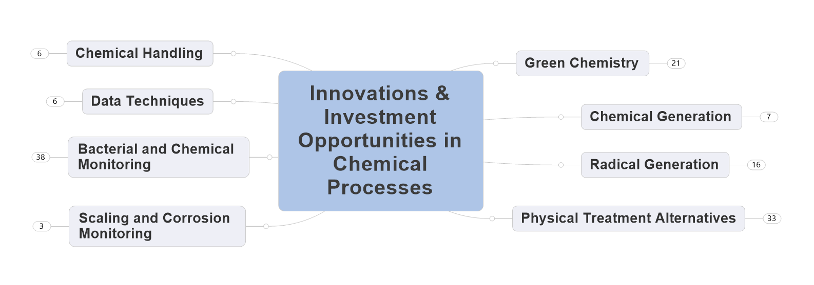
3. Future of Chemistries and Chemicals in a Circular Economy
1. Water conservation – The use of detergents and chemicals to help with Clean In Place (CIP) and rinses using reduced amounts of water. E.g. Xeros, DyeCoe and Tersus Solutions.
2. Extend life of operating equipment - Nanotechnology can use used to coat membranes with chemicals that inhibit quorum sensing and prevent biofilm formation.
3. Improve treatment performance – e.g. The development of advanced material science such as nanotech particles, carbon nanotubes (cnt), graphene membranes, bio-mimetic membranes, membrane coatings.
4. Help close the loop (MLD and ZLD) – Chemical companies can assist by advising what chemistries can be used to help to close the loop. E.g. Solenis has been able to assist clients in China who are under pressure from the regulators, to close the loop, by suggesting the optimum chemistries to help them to do this.
1. Data driven decision-making – control chemical dosing, automate cleaning cycles
2. Chemical monitoring - TRASAR is a scale inhibitor that contains a small concentration of a fluorescent dye.
1. Resistance to try something new
2. New market entrants would face these issues with economies of scale and setting up distribution channels.
3. Scale up and proof of concept - proof that a new technology will work in a new industry or in the large scale industrial setting.
1. Companies that offer end-to-end process optimization - understand the customer’s process end to end and manage it holistically. E.g. Process Miner is an example of a company, which can do this in the Pulp and Paper sector.
2. Companies that partner up with sensor companies and software companies to deliver services enabled by data and to monetise this based on the value to the customer. E.g. Nalco, with 3D Trasar, and Solenis with On-Guard.
What is driving this market?
Other assisting factors
How chemistry is used today may not be how it is used tomorrow.
In terms of circular economy, opportunities for future chemistry in water :
Dematerialise - Break the Cycle. e.g. This could be the use of hand sanitisers instead of water and the use of super-critical carbon dioxide to dye clothes and in laundries.
Use less and use it more efficiently and effectively - use less water in the first place. The use of chemicals and chemistry processes can help to reduce water use and recover water through better dewatering chemistries.
Companies are creating value from data by adding a measuring/ monitoring and data processing feature to their product offerings. E.g. Nalco, with 3D Trasar, and Solenis with On-Guard.
Market Outlook
What are the current market barriers?
Who will win out?

Slide 8
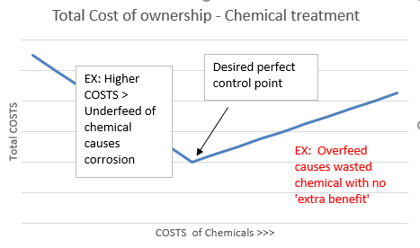
Optimization of TOTAL COST OF OPERATION
Essential in all areas of chemical treatment

Slide 9
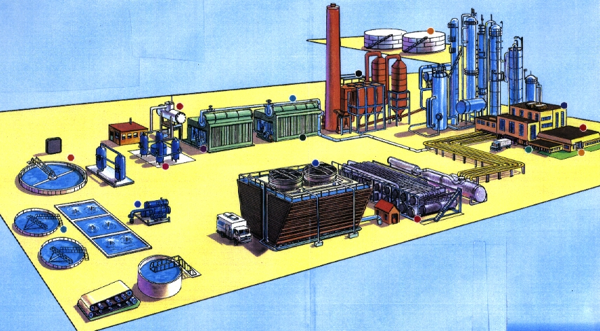
Total Water Management
Holistic view of water and process streams and impact on water utilization
Influent Water
Boiler Water
Process Water
Cooling Water
Effluent Water
Waste Water
Recycle Water

Slide 10
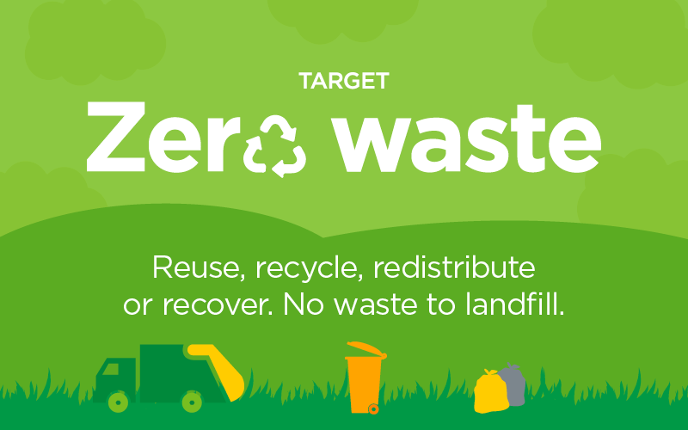
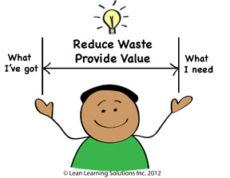
4. Transforming waste into value
1. Sustainability, sometimes regulated, around carbon and environmental footprint
2. Ensuring reliable management of residuals (secured outlets)
3. Saving sludge disposal costs
4. Energy recovery - utilizing waste heat
5. Bioplastics – consumer awareness of plastic contamination, regulatory restrictions on plastic disposal
6. Pay less on trade effluent charges
1. New technologies enabling recovery and/or reducing costs.
2. Evolution of the circular economy where bio-based and products from materials formerly considered to be wastes are considered viable options.
3. Increasing costs and reduced availability of raw materials.
1. Absence of market for recovered materials
2. Institutional and regulatory barriers – products recovered from wastes managed differently than virgin materials
3. Lack of consumer acceptance
1. Advanced water treatment (production of reuse water)
2. Waste-to-energy (anaerobic digestion, CHP, sludge hydrolysis)
3. Phosphorus recovery technologies (e.g. struvite)
What is driving this market?
Other assisting factors
Technologies enabling resource recovery are anticipated to continue to be attractive, as long as they are coupled with effective business models. The production of electricity has been widely acceptable because access to relevant markets is also widely available. Similar arrangements to allow recovered materials to be valorized will be required and are as important as the recovery technology.
Market Outlook
What are the current market barriers?
Who will win out?

Slide 11
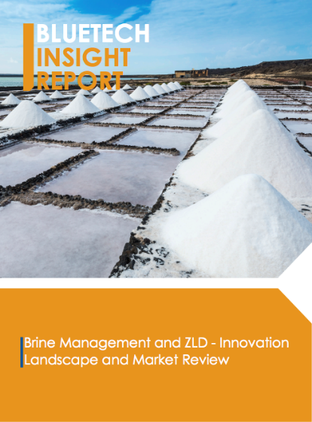
5. ZLD: Holy Grail, Fools Errand or Last Resort?
1. Regulation (always a driver)
- ZLD may be required through regulation
- ZLD may be more attractive due to regulation – ZLD can be an easier and shorter permitting path
2. Water scarcity
- Water reuse is increasingly being considered and implemented
- Cost benefit is one incentive
- Achieving positive public perception is another incentive
3. Isolated situations where ZLD is the only possible alternative
- Forced by regulation and/or limited options due to location
1. (Real - for implementation) High profit industries can afford the high costs of ZLD
2. (Real – for cost reduction) modular design, direct contact heat transfer, one-step evaporation/crystallization, higher recovery initial RO or EDR
3. (Perceived - for companies pursuing a marketplace) The promise of new and expanding markets
4. (Perceived - for companies pursuing a marketplace) The potential for cost reduction and realizing a competitive edge relative to conventional systems
1. High cost
2. Industry inertia (reluctance to implement alternatives with limited track record)
3. Challenge for new companies to provide treatment solutions rather than just a new single technology
1. High pressure and high recovery RO (and ED-based and ED-RO) systems
2. Single step evaporator crystallization systems
3. Companies offering full treatment solutions not just a technology step
What is driving this market?
Other assisting factors
Is ZLD the Holy Grail?
Yes, due to cost limitations
No, in that it should not be perceived as the ultimate solution unless viewed from a total resource and constituent recovery - the ultimate sustainable solution
No, from a technical perspective
No, for specific applications where the water quality (low salinity) avoids evaporative systems
IS ZLD a Fool’s Errand?
Yes, in the sense that present high costs – even with cost reduction – limit many applications where other options are available
Yes – for some; in the sense that the tempered rate of market growth and ZLD implementation may not support the many companies focusing on this pursuit
No, in the sense it is technically possible
Is ZLD a Last Resort?
Yes, in some cases. ZLD has less location dependence than other brine management options and can have less environmental impact than other options; it may be the only solution available for some situations.
Yes, in many situations where ZLD is implemented only when forced to by regulations or other reasons.
Market Outlook
What are the current market barriers?
Who will win out?
→ Timing is an issue BUT there will be growing markets and reduced costs
→ Major markets will be industrial
→ Some of the RO- and EDR-based modifications of RO and EDR will, at some point, make an impact on municipal systems

Slide 12
6. Decentralized wastewater treatment as an enabler for the circular economy
1. Lack of available municipal infrastructure
2. Water scarcity limiting availability of permission to take water
3. Desire to recover resources (nutrients, metals, energy, water, etc.) from wastewater
4. Physical and financial hurdles to rehabilitating ageing water/wastewater infrastructure
5. Emerging economies leap-frogging 20th Century solutions
6. Need to pre-treat industrial wastewater for either resource recovery or to satisfy discharge regulations
1. Availability of reliable, robust and affordable technologies to achieve safe, cost-effective on-site treatment
2. Removing the mystery around “advanced” technologies such as MBR, electro-coagulation, advanced oxidation, etc.
3. Externally-financed (lease, rental) options
4. Plug ‘n Play Modular Systems
5. Remote Sensing and IoT Connectivity
1. Excessive conservatism of influencers
2. Hesitance of regulators to accept and approve innovative options
3. Less-than-perfect track record of past, poorly designed, constructed and/or operated package plants
4. Water pricing that is heavily subsidized, thereby hiding the true cost of water
5. Regulations and permitting will need to change to accommodate localized/ densely-packed systems
6. Hampered by issues around monitoring, maintenance and governance
1. Suppliers of simple, modular solutions that minimize need for operator intervention and maximize resource recovery
2. Suppliers of solutions that leverage alternative financial models, such as lease/rental systems, resource harvesting and valorization, water energy purchase agreements (WEPA)
What is driving this market?
Other assisting factors
Decentralized solutions have been around for as long as, if not longer than centralized options, and will continue to be an integral and growing part of the overall infrastructure portfolio.
As end-users, particularly industrial clients, continue to recognize the value in harvesting resources from wastewater and the cost of not pre-treating high impact effluent, the growth of decentralized options will accelerate.
Population migration from depressed rust-belt regions to water-scarce new communities in the sun-belt will drive demand for on-site wastewater treatment to reuse quality.
Market Outlook
What are the current market barriers?
Who will win out?

Slide 13
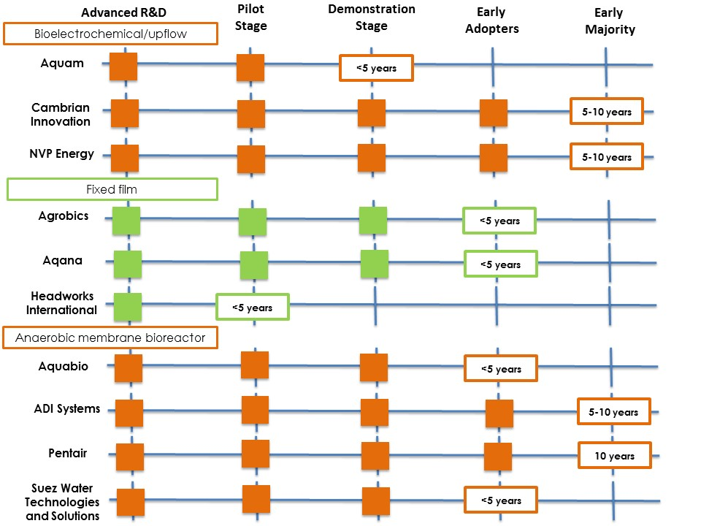
7. Anaerobic Treatment of high-strength industrial wastewater – what’s on the horizon?
The lack of robustness to “shock loads” in existing solutions is the primary driver towards new solutions, especially since industrial processes, particularly for food and beverage, are often susceptible to variability in flow quantity and strength. Additionally, some new technologies can address a wider temperature range and reduce solids generated.
Goals for sustainability—including energy efficiency, water reuse, and reduced carbon footprint—can be drivers for some facilities to consider anaerobic alternatives.
With varying degrees of success, new innovations claim to address many of the disadvantages of conventional AnT, which can include: sensitivity to temperatures below 20°C, lack of robustness, slower start-up times compared to aerobic treatment, and a requirement for tertiary treatment of aerobic polishing to meet final effluent quality.
New technologies that provide good effluent quality or can operate at low temperatures will win by addressing a broader audience including more municipal clients. Among “newer” solutions, AnMBR has most potential for meeting effluent quality standards, and low temperature operation can be achieved through biological community management.
What is driving this market?
Other assisting factors
Due to the relative complexity in operating anaerobic processes, it is likely that there will be some difficulty in getting new technology off the ground due to the need to prove the technology with high confidence.
Market outlook
There are four technologies targeting the “pain points” of conventional AnT:
Bioelectrochemical systems
New types of attached growth reactors
Incremental breakthroughs addressing upflow reactors
Mixed reactors with micro or ultrafiltration membranes
What are the current market barriers?
Who will win out?

Slide 14
8. Next-Gen Membranes as an Enabler for the Water and Re-use Market
Economic growth combined with reducing water availability
Desire to achieve good stewardship
Improve sustainability and demonstrate environmental awareness
Ability to obtain operational and manufacturing licenses
Concern with waste disposal/pollution
Open platform solution providers are providing impetus to the market by increasing confidence in product options
Product performance and quality is improving
Market is mainly consolidated around established choices (PVDF and PES), but there are also radical alternatives from Water Planet and from ceramic suppliers
Market has become wary of bespoke solutions from market leaders, which tie down the end user
Some product issues in recent years have raised concerns, especially if the user is restricted to the original supplier
Newer entrants were considered too risky in the early days of the market, but in the last few years, these options have improved significantly
Open platform solutions likely to become more important
Suppliers of larger modules will gain an advantage
New players (eg RO suppliers /BASF) gaining market share
Chinese premium product makers (eg Memstar/Scinor) likely to gain significant share in medium term
Ceramics will gain share and could become dominant in the medium term if optimized for water industry
What is driving this market?
Other assisting factors
What are current market barriers?
Who will win out?

Slide 15
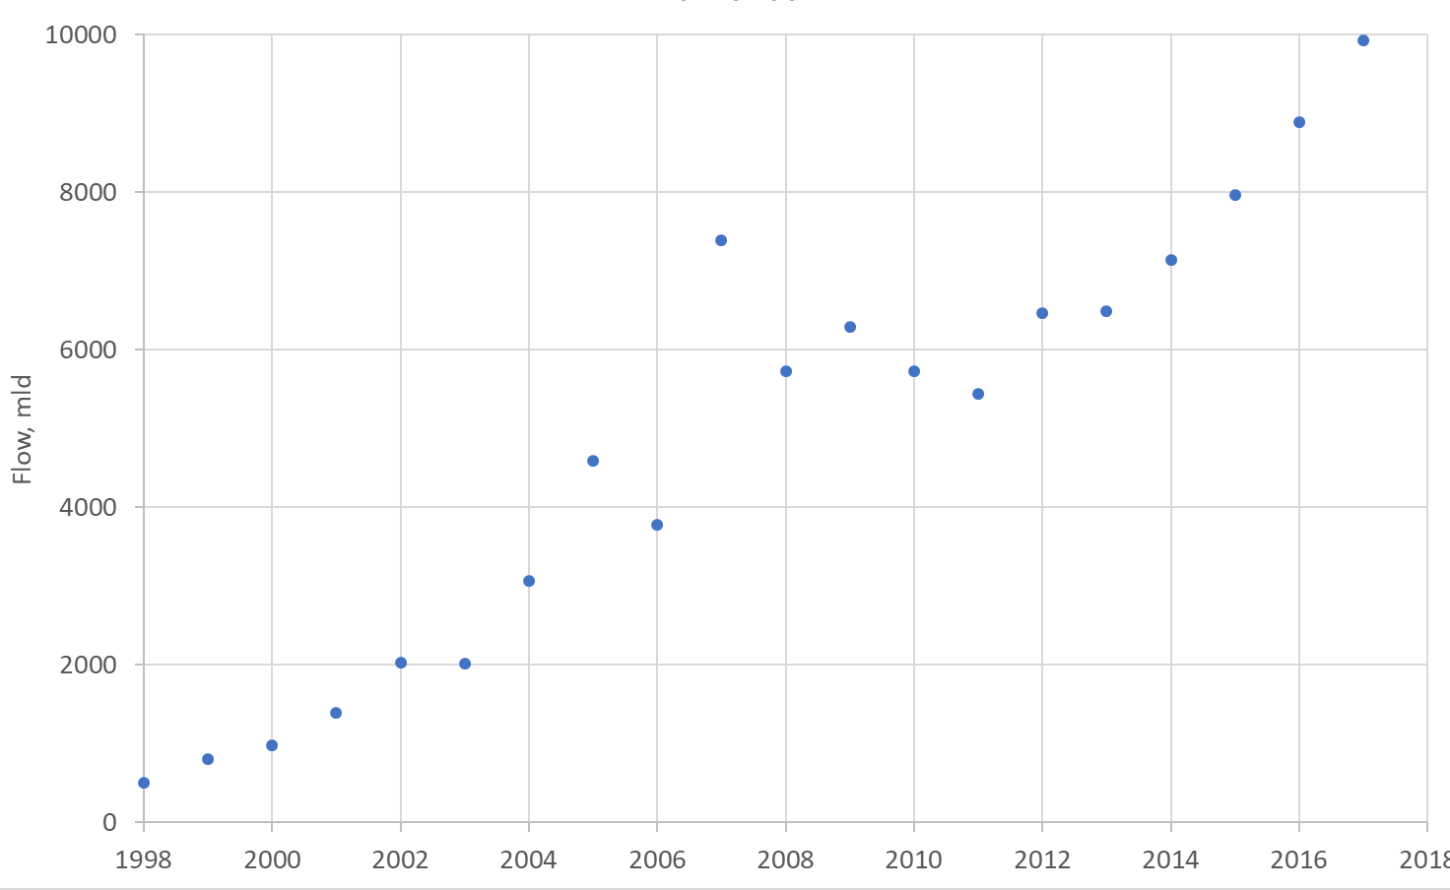
Estimated Annual Installed Membrane Filtration Flow Capacity for New Projects, mld

Slide 16
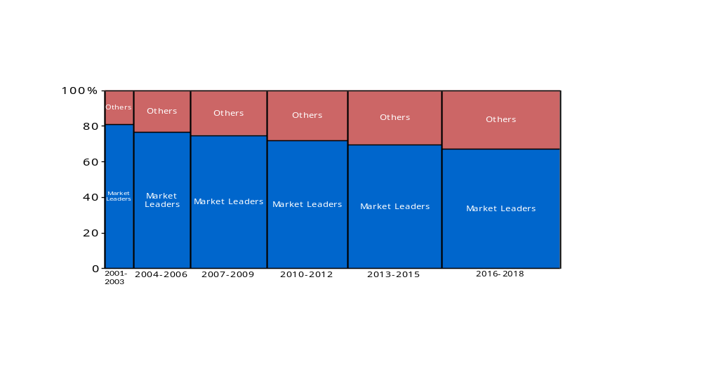
Consolidation trends in the membrane filtration market

Slide 17
Status & Outlook
Sustained and significant growth of the water membrane market, ca 10% pa
Focus on relatively few polymeric materials, ie PVDF and PES (note Water Planet introducing novel material); fibre integrity and performance improving, but developments are largely evolution rather than revolution
Ceramics beginning to make an impact, but share is currently limited since products have not been optimized for the water market
Market becoming less consolidated, with 4 market leaders gradually relinquishing share to RO suppliers/BASF
Chinese players with premium product quality, eg Memstar, Scinor, also expected to gradually make an increasing impact
Drinking water has been the dominant application segment, but SWRO pre-treatment and wastewater reuse now showing strongest growth
Route to Market likely to be strongly influenced by ‘Open Platform’ solutions based on
- ‘interchangeable’ or similar modules used in universal racks, or
- supplier specific integrated header solutions (eliminating rack manifolds)
Strong trend to increasing module size to reduce system cost (led by newer players)

Slide 18
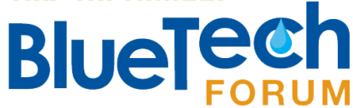
Why is water important for my business ?
Federal and State statutes and regulations such as the US Clean Water Act and Safe Drinking Water Act and those at the state level, create demand for new products and services.
1. Funding and financing infrastructure improvements.
2. Innovative state legislation such as, asset management requirements in New Jersey
2. Lead and Copper Rule – progress in reducing lead exposure.
3. Management of emerging contaminants including PFOS/PFOA/micro-plastics/legionella/algal toxins 1,4 Dioxane and others.
4. Water reuse and water conservation mandates
1. Learning from the experiences of technology vendors in getting innovative, commercial-ready products to the marketplace, including the use of testing, permitting experiences and labeling programs.
2. Advancing model approaches for technology testing that benefit early-stage companies and identifies the role(s) of cluster organizations (ISO ETV Standard emerging).
3. Encouraging cluster leader networking and collaboration.
4. Providing funding for US based early stage water companies and commercializing technologies developed by US federal and academic researchers.
1. Improved and low-cost monitoring technologies to assure regulatory compliance.
2. Cost-effective technologies for treatment and removal of emerging contaminants.
2. Testing and adoption of next generation water and wastewater technologies.
3. Continuing US drinking water and ambient water quality objectives in-line with the ‘Clean Water Act’, which requires EPA to develop criteria for ambient water quality that accurately reflects the latest scientific knowledge on the impacts of pollutants on human health and the environment and drinking water safety.
9. US REGULATORY
PERSPECTIVES
What are my top priorities/areas of focus?
What are my key innovation needs to support the environment?
How am I engaging with solution providers ?

Slide 19
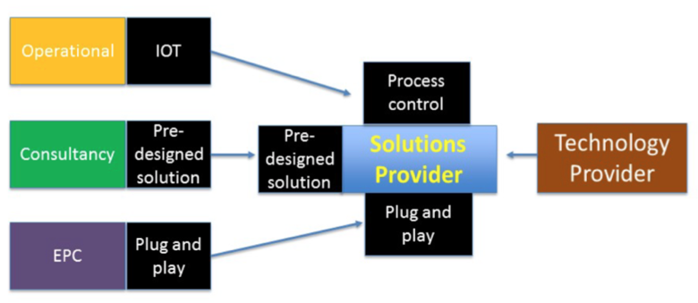
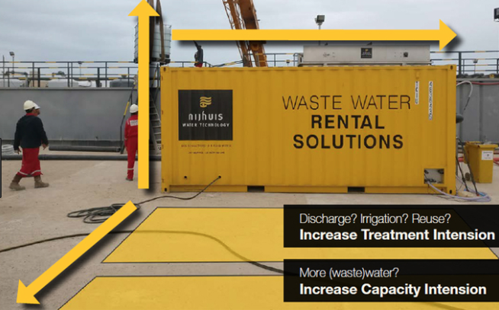

10. It’s all about the Business Model
1) Shifts in the Value Chain
A fundamental shift in the value chain towards solutions providers, or companies which seek to offer a comprehensive range of goods and services under one roof and can also become service providers through IoT-enabled remote operation and water-as-a-service business models.
3) Water-as-a-Service (WaaS) & Financing
WaaS service models can include construction, installation, ownership and operation of assets. The end user pays for performance on a per m³ basis. A recent example is Cambrian Innovation who accelerated technology adoption by offering a WEPA (Water-Energy Purchase Agreement).
Trends in Business Models
1) Shifts in the Value Chain
2) Technology Rental/Leasing
4) Data-as-a-Service (DaaS)
3) Water-as-a-Service (WaaS) and Financing Options
2) Technology Rental/Leasing
Companies offer mobile rental solutions which can include remote monitoring of technologies. Benefits:
Fast response to meet plant needs
Flexible modular solutions, easy, on-demand expansion
Tap into operational rather than capital budgets
4) Data-as-a-Service (DaaS)
Selling data to the clients using custom data analytics and machine learning (AI) algorithms. DaaS service models are usually set up as a pay as you go service with no capital expenditure required on equipment. A couple examples of DaaS providers in the water sector:
Other areas we could explore:
Value from waste plays, and example business models (Ostara, Nijhuis)
Adoption of models from other sectors -> royalty-based models?
Examples of cost-savings / profit sharing models working in water?
Other “DaaS” & optimization opportunities – increasing “up-time”, metagenomics, etc.

Slide 20
11. Disruptive Innovation in Water Technology – A meaningful or meaningless term?
If a technology does not disrupt, is it truly disruptive?
e.g. Super Critical Water Oxidation. It holds the potential to disrupt but so far has not disrupted anything.
How can we track and quantify disruption in practice?
e.g. % of new plants built that use this technology, process or business model.
How can we differentiate between sustaining innovation and disruptive innovation?
e.g. is granular sludge disruptive or sustaining? Were UF membrane in drinking water filtration disruptive or sustaining?
Clayton Christensen definition of disruptive innovation as a “process by which a product or service take root initially in simple applications at the bottom of a market and then relentlessly move up the market, eventually displacing established competitors” vs. the more commonly held understanding of this.
In water, should we speak about 'disruptive legislation’?
e.g. German and Swiss Legislation requiring treatment for removal of micro pollutants. Or a policy shift towards circular economy and resource recovery.
Is market and technology fragmentation a buffer against disruption?
In the same way genetic diversity provides resilience in populations to the rapid spread of disease.
e.g. biological wastewater treatment comes in many flavors, SBR, MBR, MBBR, RBS,
and conventional activated sludge.
Should we really be looking for systems level disruptions in water as opposed to smaller technology changes within the current paradigm?
e.g. decentralized treatment, zero liquid discharge, energy neutrality.

Slide 21
12. Climate Change Needs and Opportunities
1. All infrastructure is challenged by climate change.
2. Barriers to change for infrastructure is change itself.
3. Markets need to move to the view that climate change is an opportunity
What is driving this market?
Other assisting factors
1. Climate change is a fact.
2. Climate change must be addressed at all levels: Municipal and state government as well as corporations.
3. Currently the major focus is on risk and sustainability.
1. Emerging new leadership in enterprises.
2. Real time technologies.
3. More extreme weather events.
1. For water infrastructure: Never-ending.
2. For corporate board support: Only increasing.
3. For increasing value: Never-ending.
Market Outlook
1. Those who make climate change a leg in their business plan.
2. Those whose boards embrace new ideas to maximize value.
3. Those companies who value their employees’ support/pride.
What are the current market barriers?
Who will win out?

Slide 22
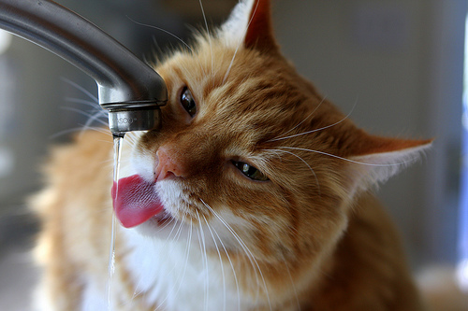
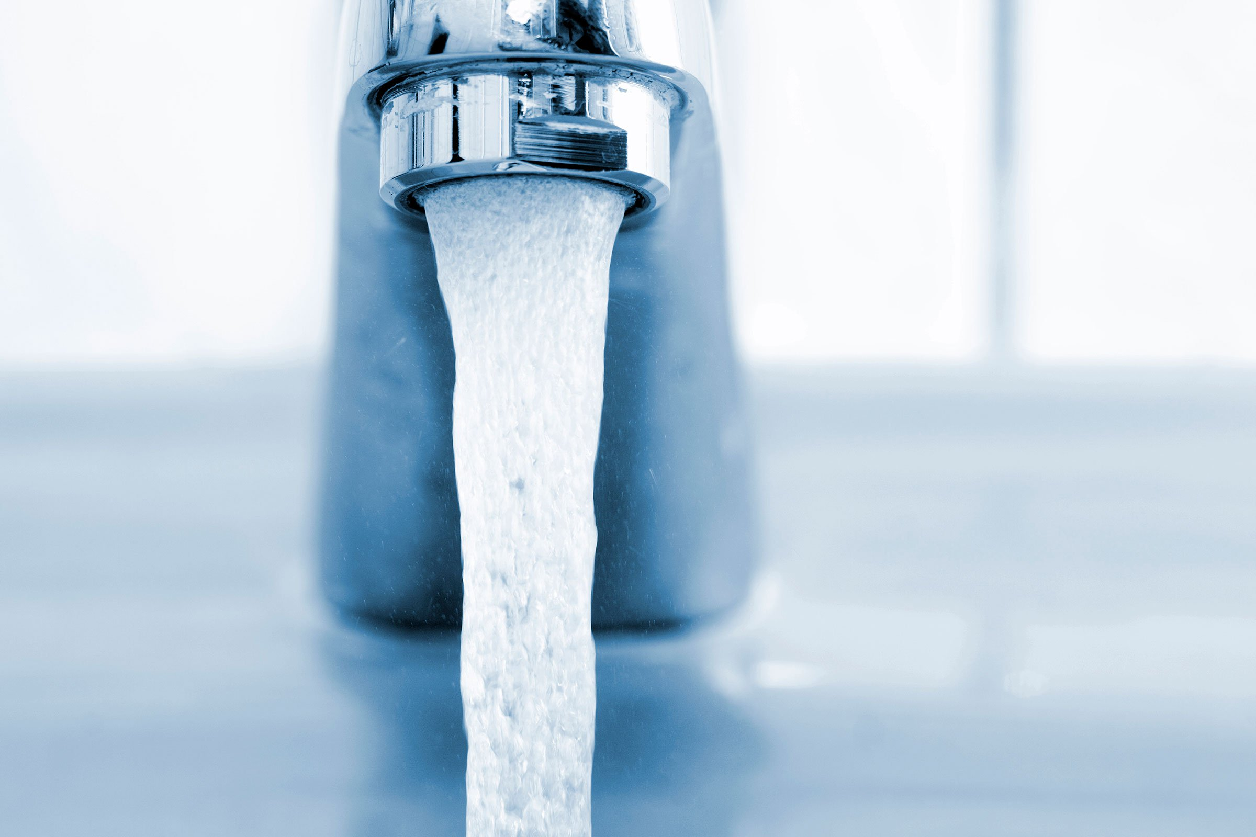
13. Emerging Trends in Point-of-Use (POU) and Point-of-Entry (POE) Systems
1. New Reports
2. Water contamination issues (e.g., Flint, MI)
3. Growing awareness of poor tap water quality in many areas of the world
4. Municipal water utilities cannot afford to deal with failing infrastructure and increasing contaminant removal to meet more stringent standards
5. Water Scarcity
6. New ways of marketing to urban customers (i.e., online, Amazon, etc.)
7. A plethora of new products (e.g., countertop, under the sink, whole house)
1. Easier Access via online shopping
2. Internet Of Things (IoT) provides connectivity, promise of safety, and better support from supplier
3. Increased connectivity to ensure proper maintenance of home treatment devices alleviates concerns of regulators
1. High Costs: - devices are not cheap
2. Increasingly crowded market; many new entrants
3. Competition between traditional suppliers and new entrants
- Traditional market leaders (Culligan, EcoWater, Kinetico) sell POU and POE devices to rural and small municipal customers through a network of dealers
- Newer entrants (Pur, Brita, others) sell online, through big box stores, and typically feature pour thru pitchers, countertop or single faucet purifier devices
4. Who is going to win the IoT competition as homes become increasingly connected?
5. Providing timely and effective service and maintenance
6. Costly certifications required to meet regulations and the requirements of informed consumers
1. Traditional suppliers (Culligan, EcoWater, Kinetico) will continue to prosper in more rural markets while striving to find ways to access and capitalize on urban markets around the world
2. Newer entrants will win via newer channels of distribution (Online Sales, Amazon, Big Box Stores)
3. Whichever suppliers win the battle for most cost-effective connectivity in the home (i.e., winning with best IoT offerings)
4. Those who master online marketing and sales
5. Whole House Units (representing final barrier to ensure safety and quality)
6. Those who can provide timely and effective service and maintenance
What is driving this market?
Other assisting factors
Growing population means means increased water scarcity, more contaminants and pollutants, more awareness of water issues, all of which translates into strong global growth for POU/POE devices and units.
The Global Market is growing rapidly, led by burgeoning markets in Asia and steady growth in North America.
Market Outlook
What are the current market barriers?
Who will win out?

